Slide 1




Wicked Movie Reviews
Brian Pan

Slide 2
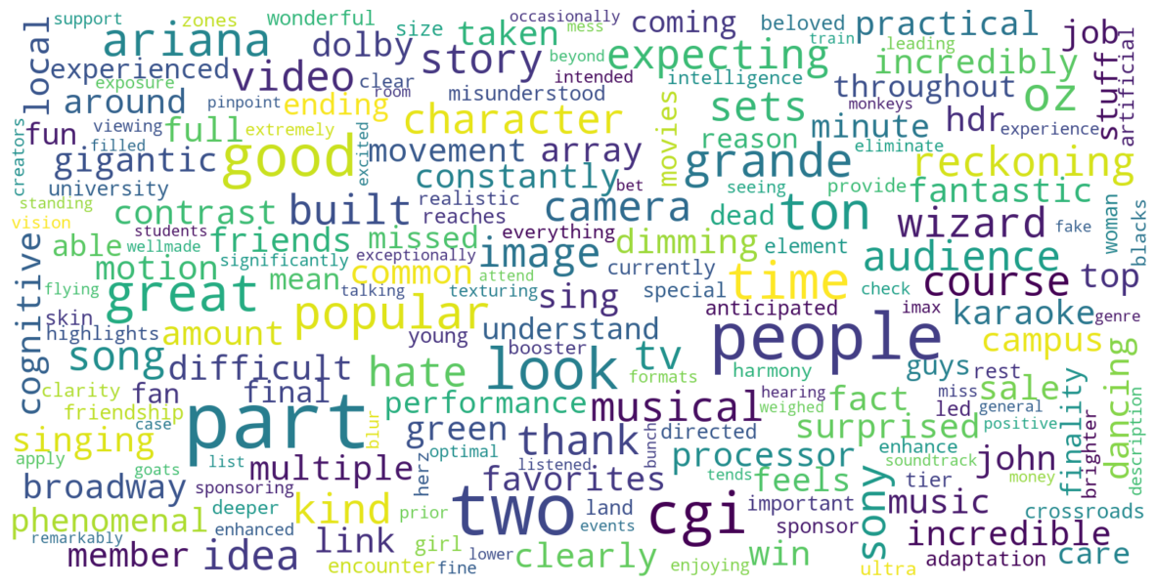
WordCloud
More on jupyter notebook file

Slide 3

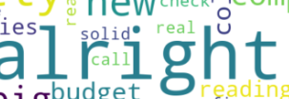
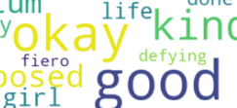
















WordCloud
General Patterns Noticed
Positive Sentiments
Emphasis on Musical
Productions
Strong Sentiments

Slide 4
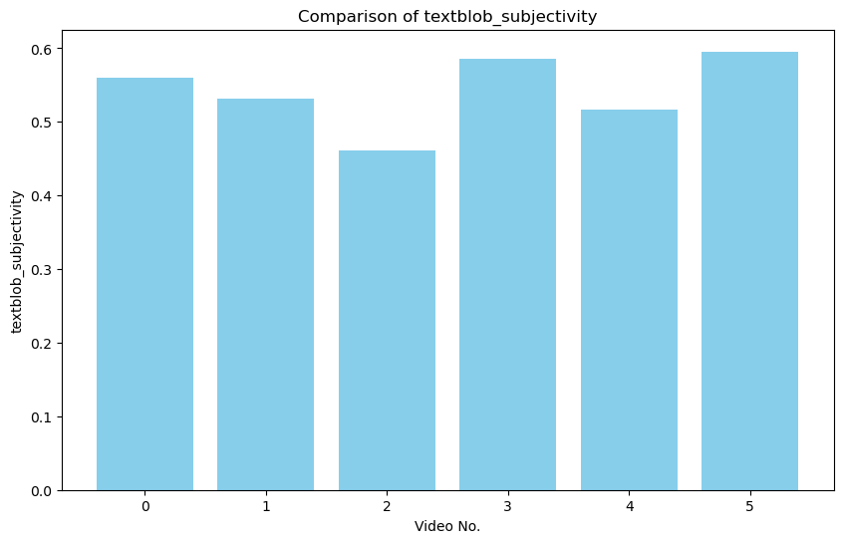
Subjectivity
Most videos are slightly subjective (above 0.5) but close to midway point between subjective and objective
Some variation exists
For example, Video 2 is noticeably less subjective than the others

Slide 5
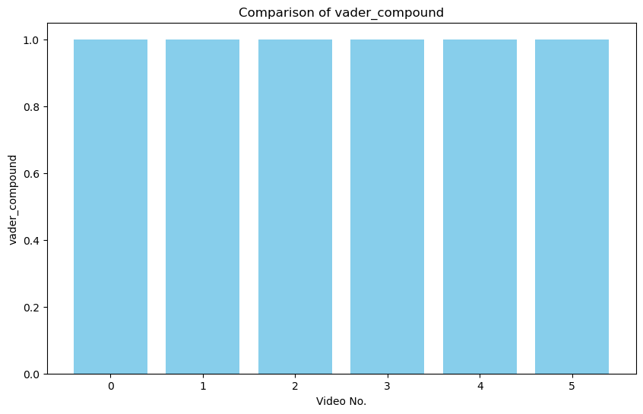
Vader Scores
Vader Compound Score combines all Vader scores: Positive, Neutral, and Negative into one score
A score above 0.05 is considered to be positive
For all videos, Wicked seems to garner overwhelmingly positive feedback

Slide 6
Summary of Partition
Method:
By looking at the two charts, we first isolate each criteria separately and see which videos match it.
Next, we find the intersecting matches between the two to find what meets our sorting criteria.
For instance, High Textblob_Subjectivity and Low Vader Positive would be Negative-Subjective
Category | Video No.
Negative-Objective | 2
Negative-Subjective | 3
Positive-Objective | 1.4
Positive-Subjective | 0,5

Slide 7
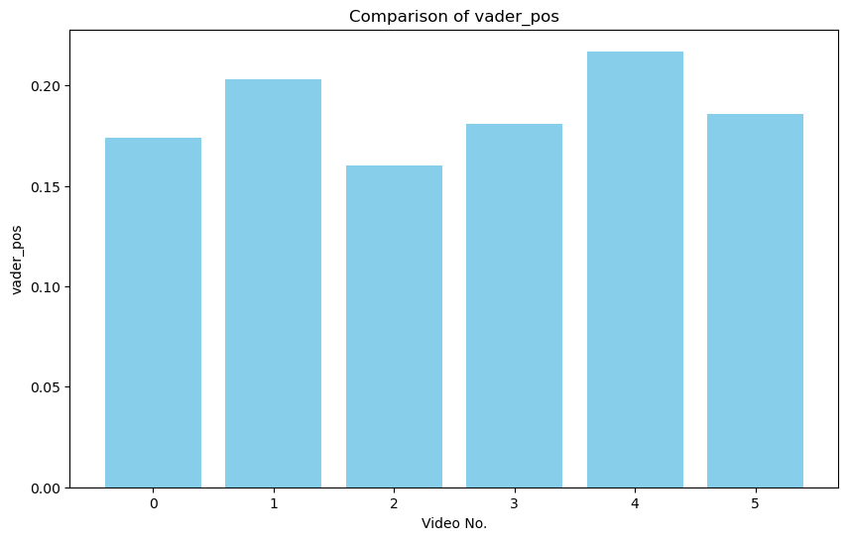







Objective – Negative

Slide 8







Subjective - Negative

Slide 9





Objective - Positive

Slide 10







Subjective - Positive

Slide 11



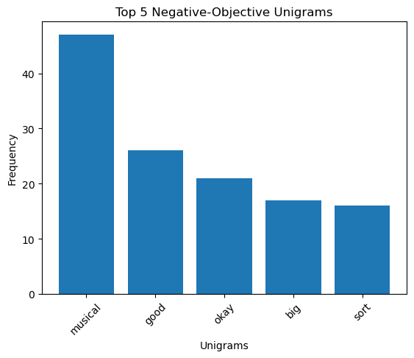
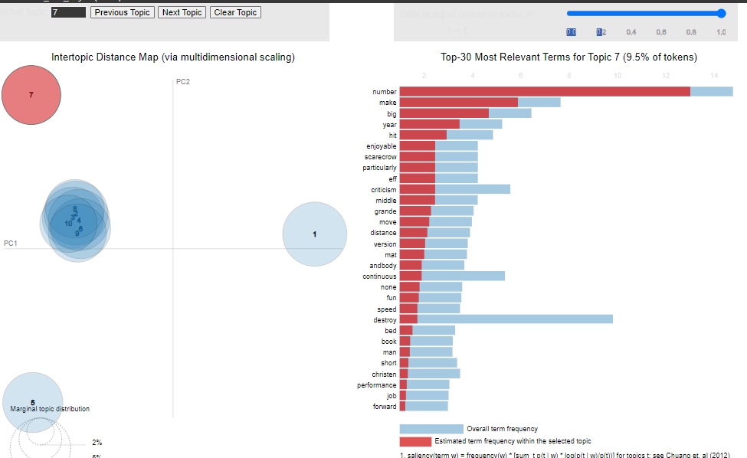
Topic Modeling vs ngams

Slide 12
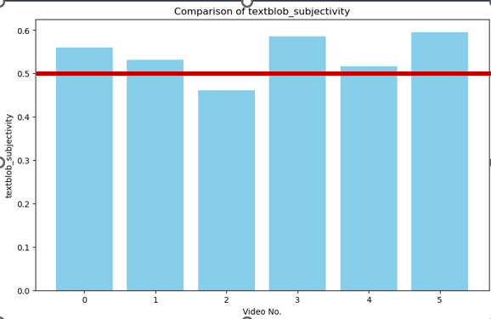
Topic Modeling vs ngams
Qualities of Topic Modeling
Two Visual Features: Global Perspective Conditional Distribution of Terms
Selection of Topics
Clustering Functionalities
Dimension Reduction
Ambiguity
Bag of Words
Extensive Pre-Processing
Unsupervised

Slide 13
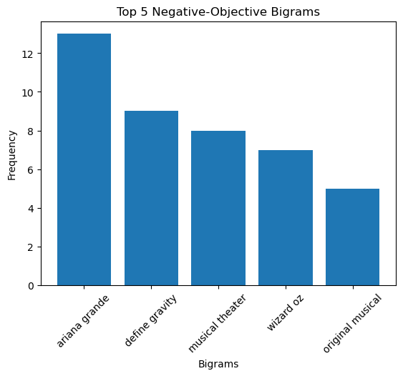
Topic Modeling vs ngams
Qualities of n-grams
Simple Visual
Easy to interpret
Captures context at the local level
Robust to noise
Less technical
Visible Collocations
Idiomatic Expressions
Lack of clustering
No dimension reduction

Slide 14
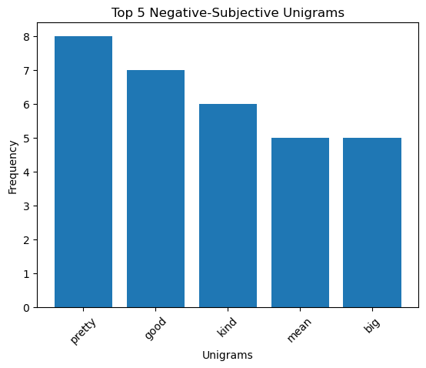
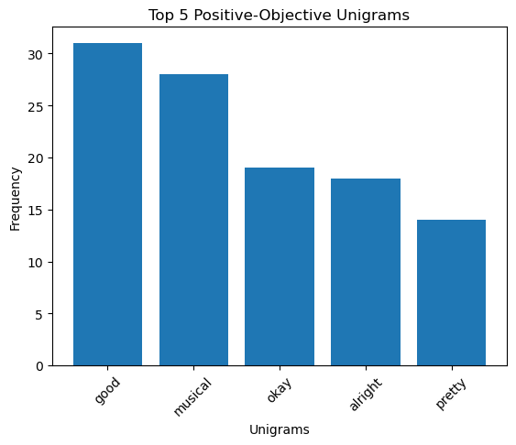
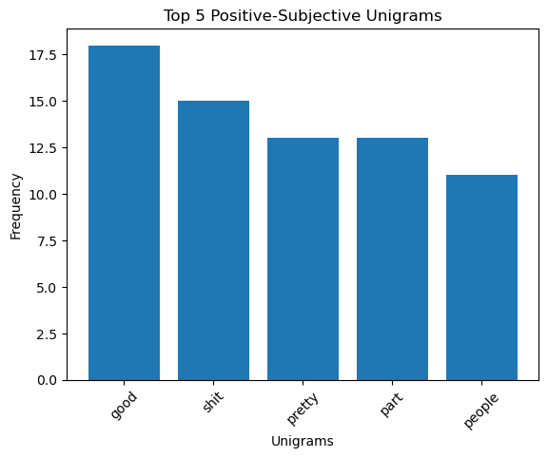










Unigrams
‘good’ appears in all ‘Top 5’ unigrams
The following terms appear in two of the four unigrams:
‘musical’
‘okay’
‘big’
Most interesting difference is with positive-subjective, containing profane remarks

Slide 15
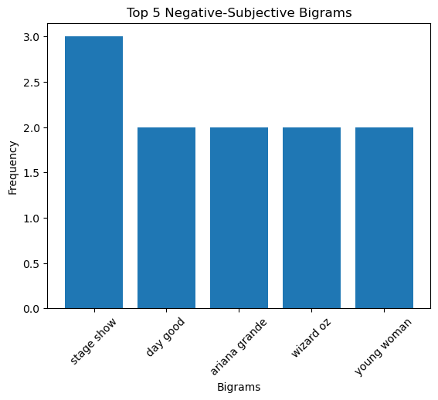
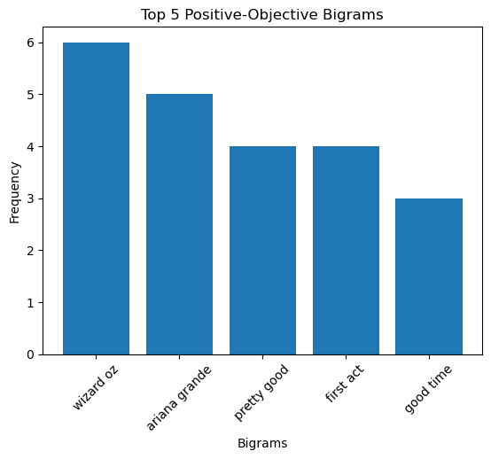
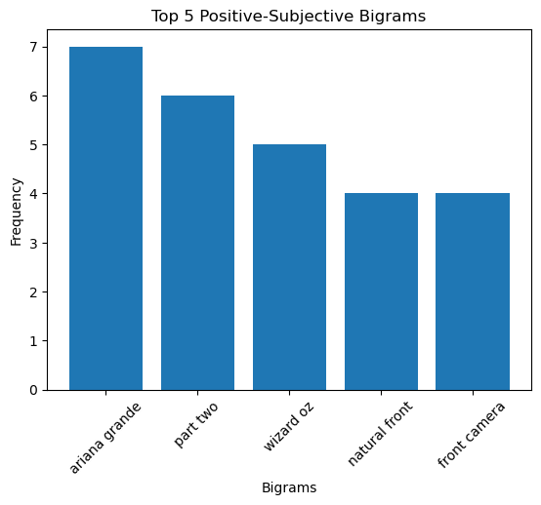








Bigrams
‘Ariana grande’ and ‘wizard oz’ are prevalent in all four bigrams
Similar theater references for all except positive-subjective
‘musical theater’
‘first act’
‘stage show’
Positive-Subjective focuses on the cinematic aspect
‘part two’ instead of ‘second act’
‘front camera’

Slide 16
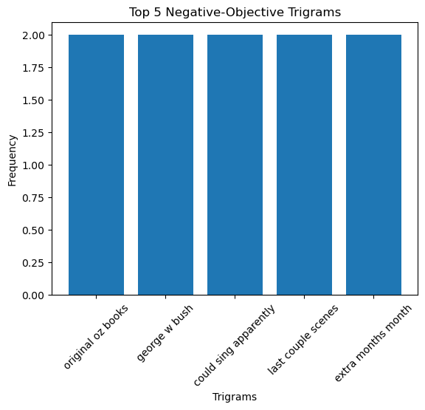
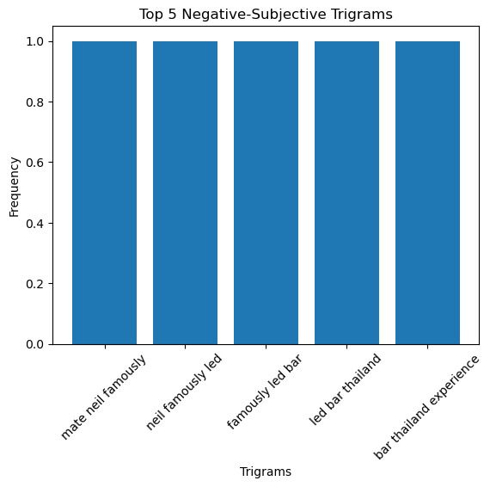
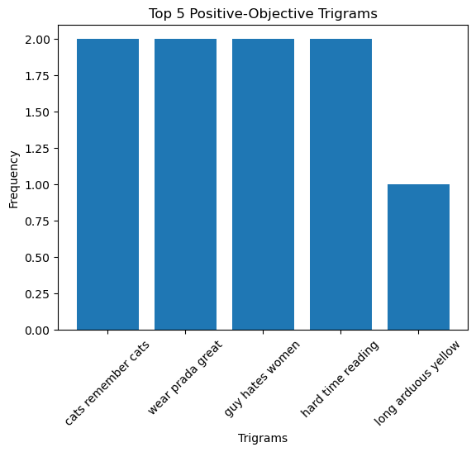
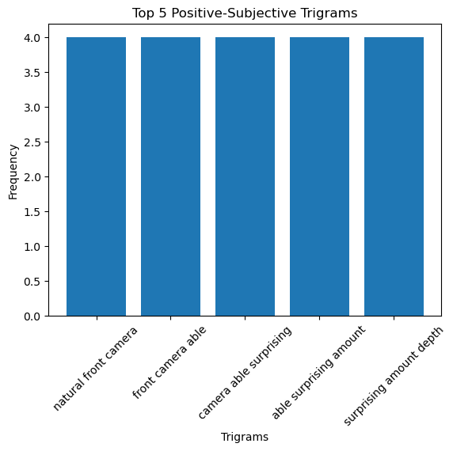








Trigrams
Excluding Positive-Subjective, all other trigrams deviate off topic
Reflects podcasting hosts conversational style of video
Small sample size a potential factor as well
Positive-Subjective stays focused on the film

Slide 17
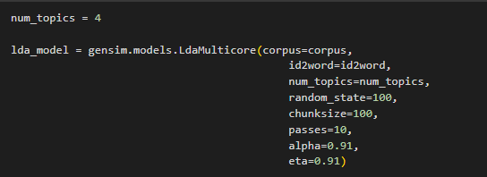
Topic Modeling
Advantages | Disadvantages
Discovers hidden themes | Lack of context
Reduces dimensionality | Not deterministic
Organizes classifications to summarize the documents | No straightforward method of evaluating a model
Good for longer texts | Subjective interpretation
An unsupervised classification of documents, similar to clustering, that finds natural groups of topics
Is a generative probabilistic model
Employs Bag-of-words
Inherently stochastic
Uses a similar method to PCA
K-value: count of topics
‘alpha’: P(Document-Topic Density)
‘eta’: P(Word-Topic Density)

Slide 18
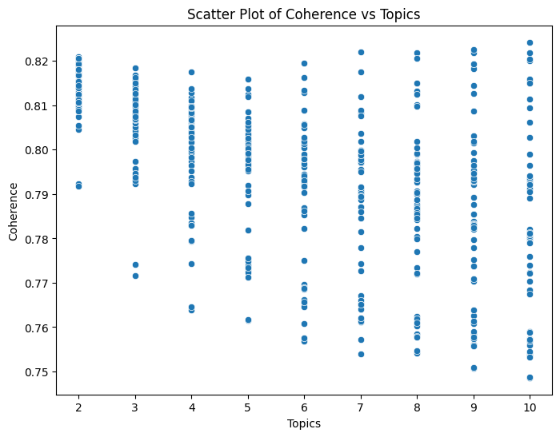
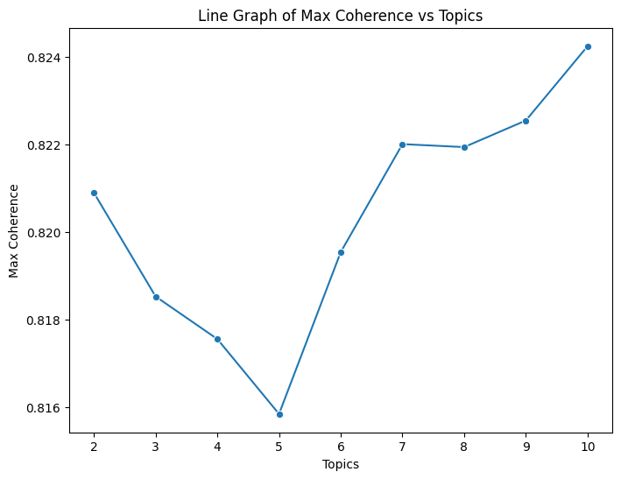
Optimized Coherence
Coherence and Perplexity are inversely correlated. Coherence measures degree of topics are semantically similar. Perplexity measures how surprised model is with new data, given previous data.
Optimizing perplexity is hard to interpret, so we optimize for coherence.
Dispersion based randomness and hyperparameters such as alphas and betas

Slide 19
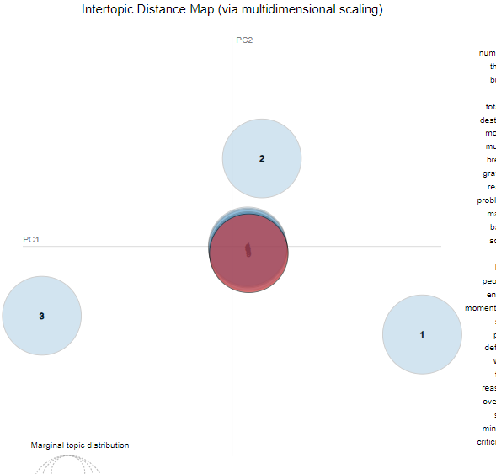
Modeling Issues
Optimized coherence not always exact
Likely due to stochastic nature
High k leads to duplicated topic
Can be visualized as overlapping circles
Lower k-values can yield similar coherence scores

Slide 20
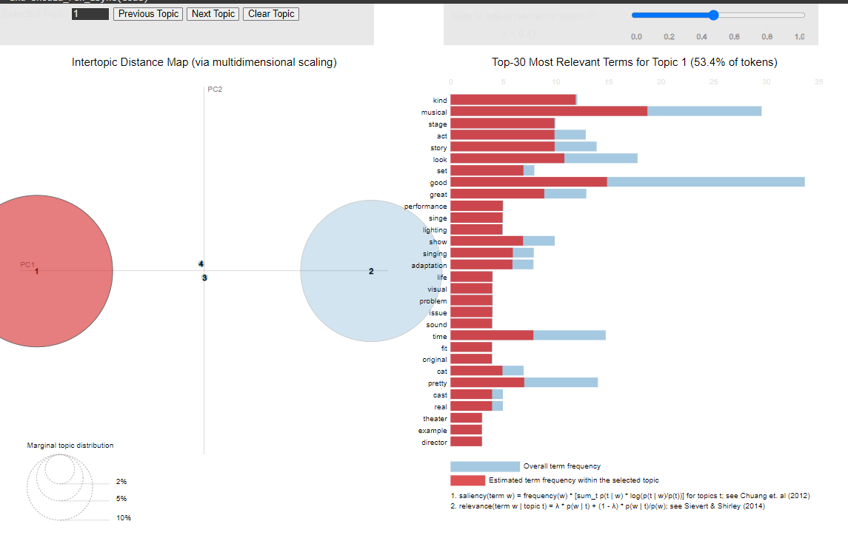
Reading Intertopic Distance Map
Lambda
Salience
Relevance
Circle Size
Intertopic Distance

Slide 21
Reading Intertopic Distance Map
Lambda
Salience
Relevance
Circle Size
Intertopic Distance
1
2
3

Slide 22
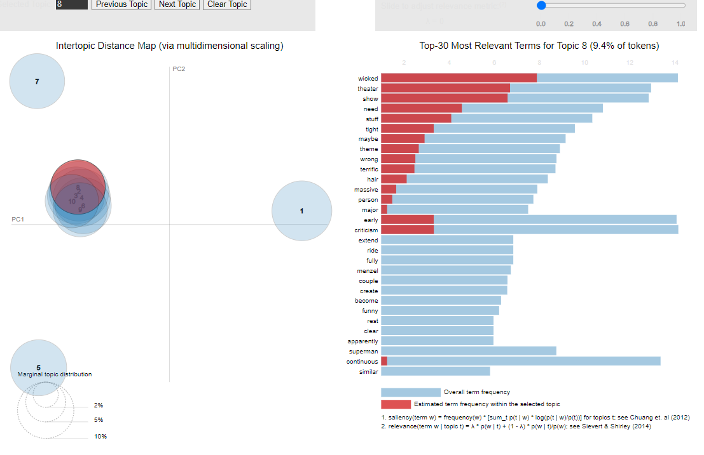
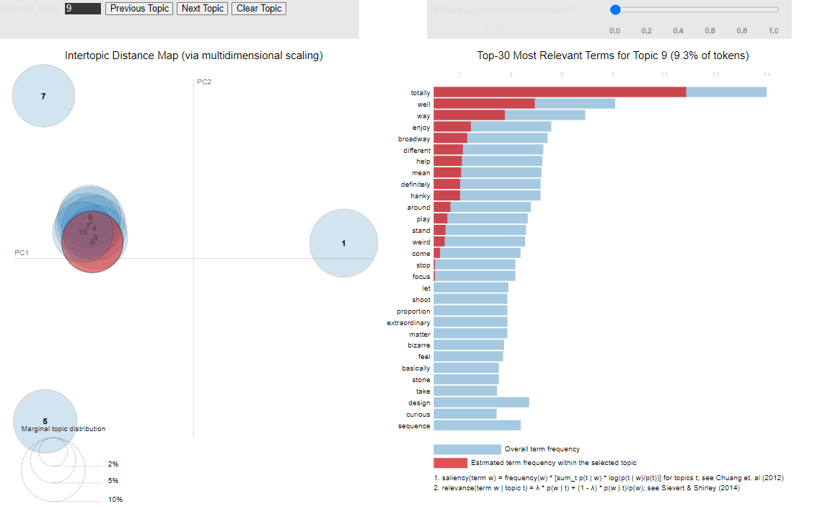
LDA - pyLDAvis

Slide 23
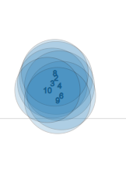


LDA - pyLDAvis
Overlap of Topic 8 and Topic 9 suggests similar meanings are within close intertopic distances. Here, Topic 8 has terms ‘theater’ and ‘show’ while Topic 9 has ‘broadway’
Close Up of Overlapping Topics

Slide 24
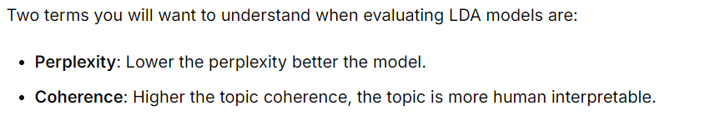
LDA: Summary of Findings
 | Negative-Objective | Negative-Subjective | Positive-Objective | Positive-Subjective
Optimum topics | 2 | 4 | 4 | 3
Optimum word per topic | 312 | 87 | 353 | 392
Perplexity | -7.04 | -6.74 | -8.48 | -9.24
Coherence Score | 0.81 | 0.82 | 0.27 | 0.23

Slide 25




LDA: Summary of Findings
 | Negative-Objective | Negative-Subjective | Positive-Objective | Positive-Subjective
Optimum topics | 2 | 4 | 4 | 3
Optimum word per topic | 312 | 87 | 353 | 392
Perplexity | -7.04 | -6.74 | -8.48 | -9.24
Coherence Score | 0.81 | 0.82 | 0.27 | 0.23
Expectation: Low Perplexity
High Coherence
Highest Perplexity
Highest Coherence

Slide 26
LDA: Summary of Findings
 | Negative-Objective | Negative-Subjective | Positive-Objective | Positive-Subjective
Optimum topics | 2 | 4 | 4 | 3
Optimum word per topic | 312 | 87 | 353 | 392
Perplexity | -7.04 | -6.74 | -8.48 | -9.24
Coherence Score | 0.81 | 0.82 | 0.27 | 0.23
Video Length | 20 min (one video) | 6 min (one video) | 20 min (two 10-min video) | 20 min (two 10-min video)

Slide 27








LDA: Summary of Findings
 | Negative-Objective | Negative-Subjective | Positive-Objective | Positive-Subjective
Optimum topics | 2 | 4 | 4 | 3
Optimum word per topic | 312 | 87 | 353 | 392
Perplexity | -7.04 | -6.74 | -8.48 | -9.24
Coherence Score | 0.81 | 0.82 | 0.27 | 0.23
Video Length | 20 min (one video) | 6 min (one video) | 20 min (two 10-min video) | 20 min (two 10-min video)
Topic size correlates with corpus size
Coherence is sensitive to number of documents

Slide 28
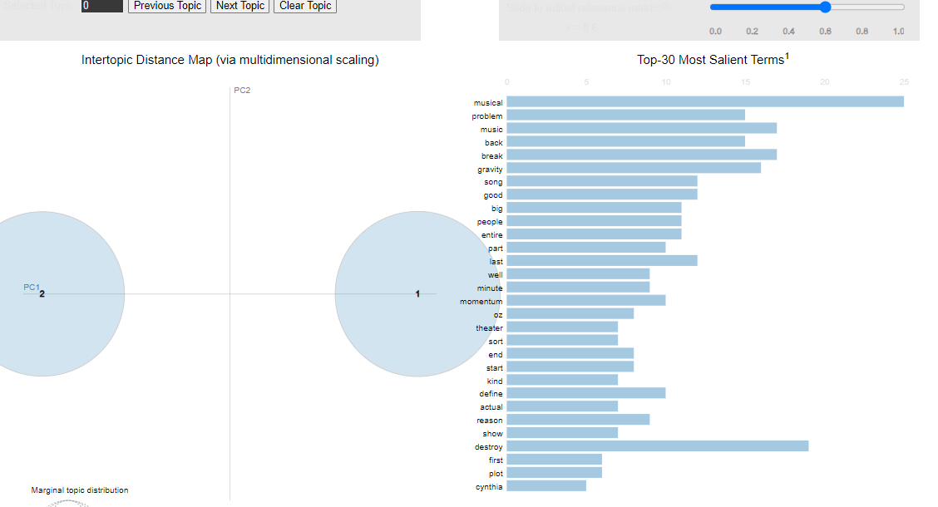
Topics: Negative-Objective
Perplexity | -7.04
Coherence | 0.81
Len(Corpus) | 630

Slide 29
Topics: Negative-Objective
Topic No. | Potential Topic Names | Top Relevant Terms | Size %
1 | Musical | Big, song, gravity, music, theater, plot | 50.2%
2 | Production | Problem, back, people, entire, part | 49.8%
Perplexity | -7.04
Coherence | 0.81
Len(Corpus) | 630

Slide 30
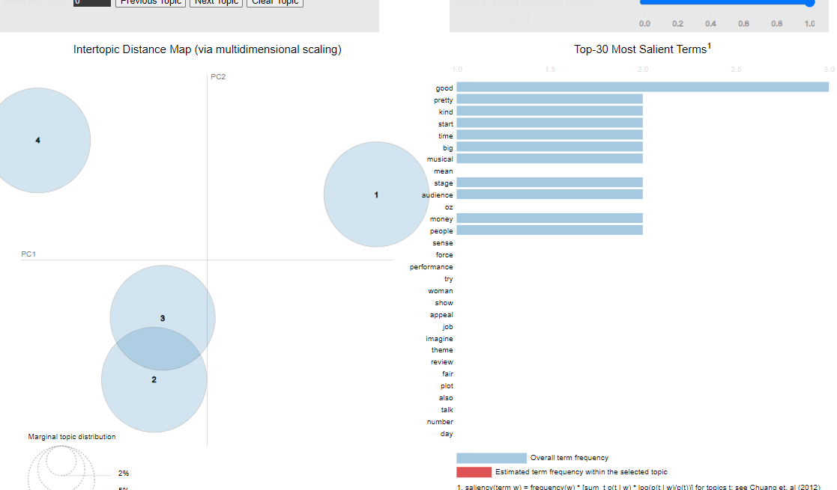
Topic: Negative-Subjective
Perplexity | -6.74
Coherence | 0.82
Len(Corpus) | 348

Slide 31
Topic: Negative-Subjective
Perplexity | -6.74
Coherence | 0.82
Len(Corpus) | 348
Topic No. | Potential Topic Names | Top Relevant Terms | Size %
1 | Characteristics | Kind, smart, time, plot, power, run | 25%
2 | Theater | Big, musical, mean, stage, audience | 25%
3 | Logistics | Pretty, stage, oz, money, people | 25%
4 | Reception | Good, audience, force, sense, performance | 25%

Slide 32
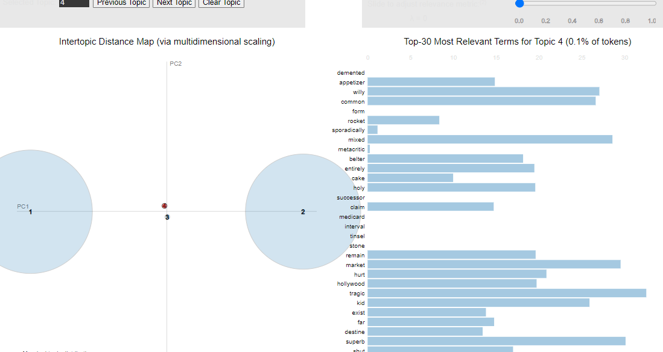
Topic: Positive-Objective
Perplexity | -8.48
Coherence | 0.27
Len(Corpus) | 662

Slide 33
Topic: Positive-Objective
Perplexity | -8.48
Coherence | 0.27
Len(Corpus) | 662
Topic No. | Potential Topic Names | Top Relevant Terms | Size (%)
1 | Production | Example, visual, life, stage, performance, sound, issue, fit, director, lighting | 53.4%
2 | Audience sentiments | Fucking, fuck, quick, guess, completely, ride, hate, turn, joker, review | 46.5%
3 | Fantasy | Fantasy | 0.1%
4 | Misc | Appetizer, rocket, sporadically, mixed, metacritic | 0.1%

Slide 34
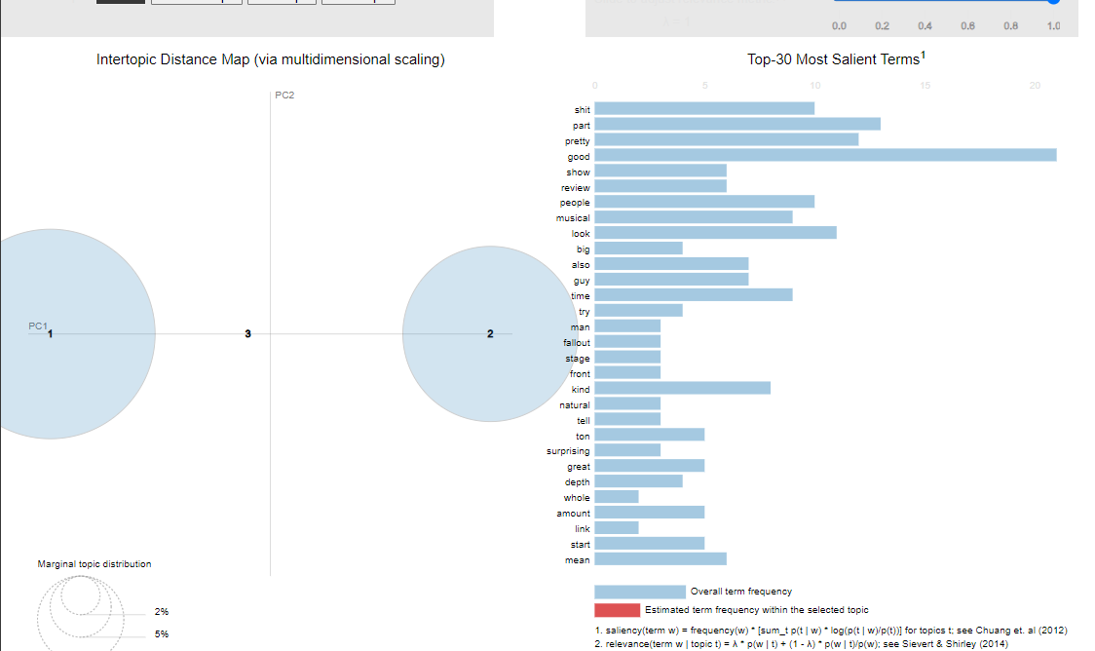
Topic: Positive-Subjective
Perplexity | -9.24
Coherence | 0.23
Len(Corpus) | 667

Slide 35
Topic: Positive-Subjective
Perplexity | -9.24
Coherence | 0.23
Len(Corpus) | 667
Topic No. | Potential Topic Names | Top Relevant Terms | Size (%)
1 | Theater | show, stage, plot, social, whole | 58.8%
2 | Cinema | Enhance, tv, dolby, idea, cgi | 41.2%
3 | Acting | Face, amazing, motion, tilt | 0.1%

Slide 36







Topics Side-by-Side Comparison
Distinction is
Objective focuses on audience impressions, fantasy
Subjective focuses on acting, reception, character traits
Common to both is
Musical/Theater
Production
Objective |  | Subjective
Negative-Objective | Positive-Objective | Negative-Subjective | Positive-Subjective
Musical | Production | Characteristics | Theater
Production | Audience sentiments | Theater | Cinema
 | Fantasy | Logistics | Acting
 | Misc | Reception
Objective reviews tend to focus on how the audience feels about the movie, while subjective reviews focus on acting and technicalities of the movies itself.
Objective reviews evaluate based on how the audience feel about the film
Has a balance of good and bad remarks
Subjective reviews only focuses on the film itself
Creates bias towards supporting the film

Slide 37







Topics Side-by-Side Comparison
Positive |  | Negative
Positive-Subjective | Positive-Objective | Negative-Subjective | Negative-Objective
Theater | Production | Characteristics | Musical
Cinema | Audience sentiments | Theater | Production
Acting | Fantasy | Logistics
 | Misc | Reception
Similar to Objective-Subjective, Positive-Negative retains the same balance of distinctions. Positive is focused more on audience sentiments while Negative is focused on the film itself.
May attributed to small sample size of the study
Can also be explained by Negative review being overly technical in their review and lacking emotional appeal

Slide 38

Additional resources
F, Sydney. “Getting to the Point with Topic Modeling: Part 3 - Interpreting the Visualization.” Maveryx Community, 7 June 2023, community.alteryx.com/t5/Data-Science/Getting-to-the-Point-with-Topic-Modeling-Part-3-Interpreting-the/ba-p/614992#:~:text=The%20intertopic%20distance%20map%20is,each%20topic%20across%20the%20dictionary.
P, Aditya. “How Do You Evaluate the Coherence and Perplexity of Your Topic Models with Gensim?” Topic Modeling with Gensim: Coherence and Perplexity, 25 Aug. 2023, www.linkedin.com/advice/1/how-do-you-evaluate-coherence-perplexity.
Sievert, Carson, and Kenneth E. Shirley. LDAvis: A Method for Visualizing and Interpreting Topics, aclanthology.org/W14-3110.pdf. Accessed 10 Dec. 2024.
“Understanding LDA / Topic Modelling -- Too Much Topic Overlap.” Stack Overflow, 1 Nov. 1962, stackoverflow.com/questions/46326173/understanding-lda-topic-modelling-too-much-topic-overlap.
AIML.com. “What Is Topic Modeling? Discuss Key Algorithms, Working, Applications, and the Pros and Cons.” AIML.Com, 17 Oct. 2024, aiml.com/what-is-topic-modeling/#:~:text=Lack%20of%20Context%3A%20Topic%20modeling,ability%20to%20capture%20nuanced%20meanings.&text=Ambiguity%3A%20Some%20words%20may%20appear,interpreting%20topics%20and%20their%20boundaries.

Slide 39
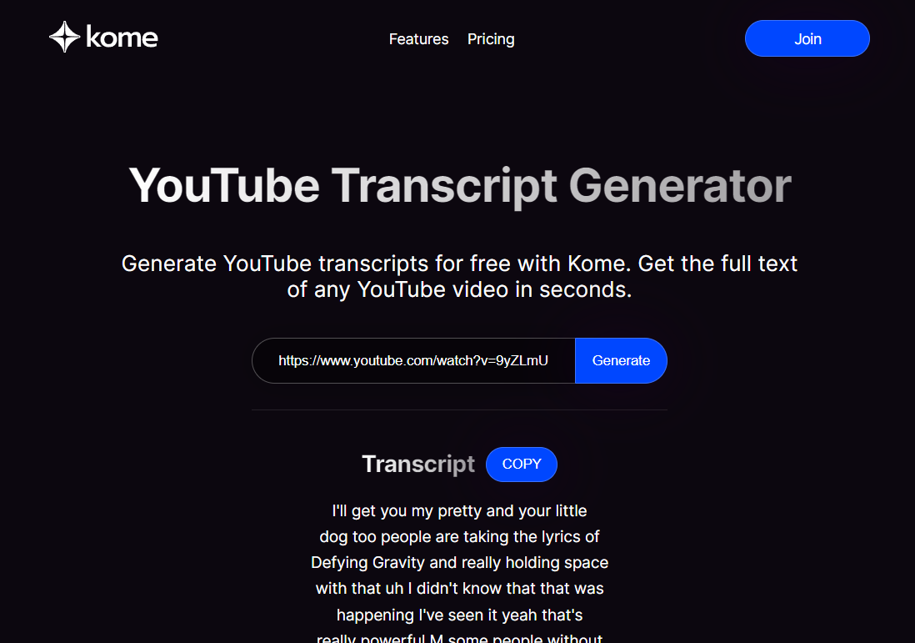
Kome.ai
“All-in-one tool for knowledge”
Caters to individuals
Primarily a transcription service
Transcription not exportable
Available as “copy”
Marketing convenience
Bookmark feature
Summary capabilities
“email” extraction feature
Wants to be your companion
Browser Extension
Free to use
Sign up for account customization
Basic plan is at $5/mo

Slide 40
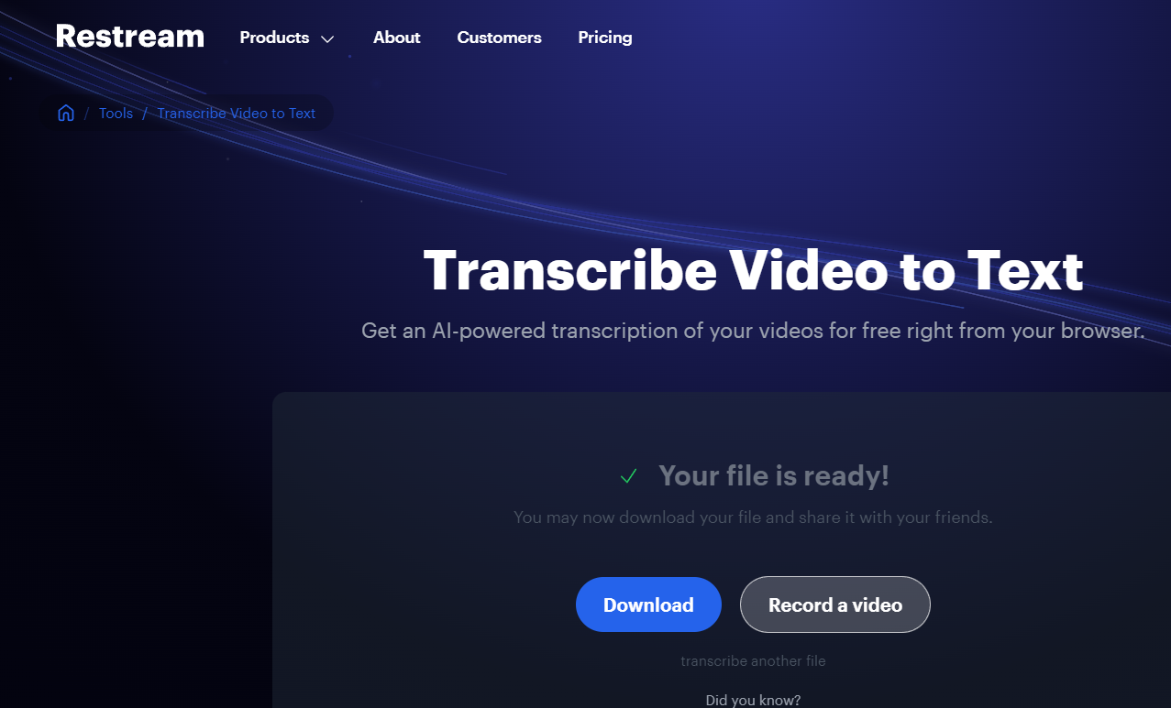
Restream.io
“We help stories be seen and heard”
Caters to Video Streamers
Considerably larger company
Provides multi-streaming capabilities, video editing studio, and technical support service
Transcription was a free feature
Download as txt
Account sign up required for additional functionalities
Team environment available
Enterprise pricing available
Starting price at $16/mo

Slide 41
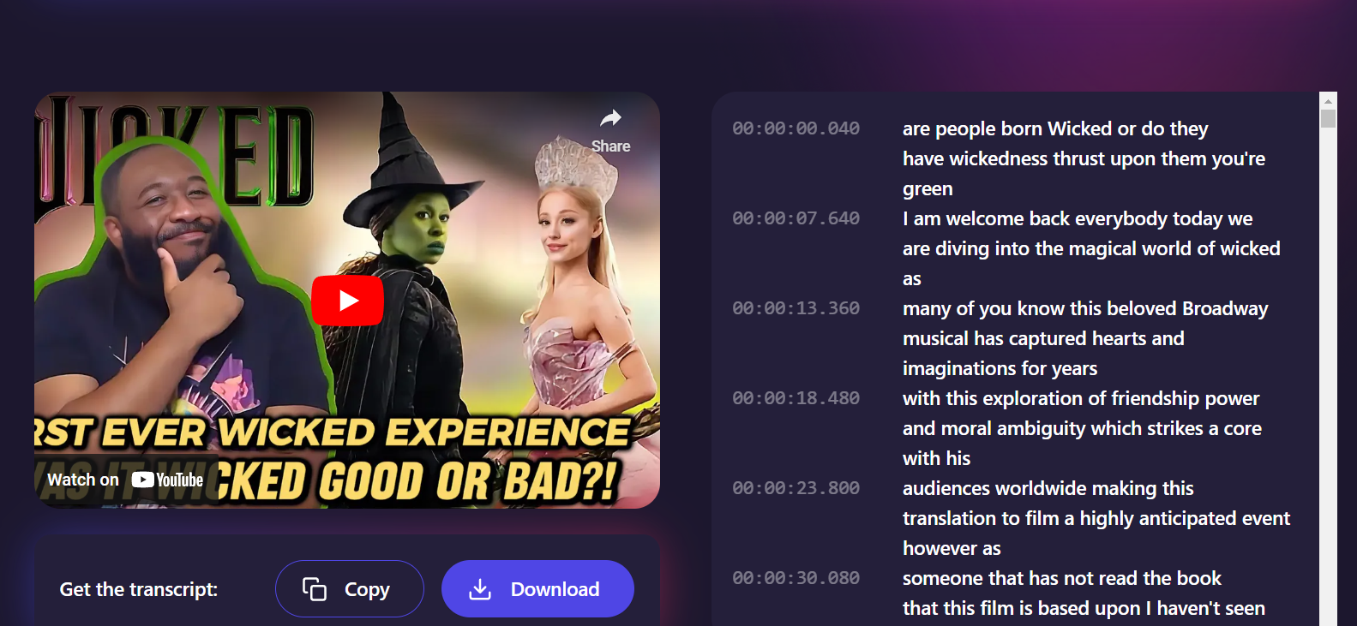
Tactiq.io

Slide 42
Tactiq.io
“Focus on the Meeting, let AI handle the notes.”
Caters to businesses
Primarily a meetings productivity app
Selling point is transcription of live meetings
Integrates with Google Meet, Zoom, Microsoft Teams
Browser Extension available
Video transcription is free
Export as txt
Timed transcription
Team environment available
Basic subscription starts at $12/mo
Enterprise options available

Slide 43


Transcription Services
Youtube-Compatible | ✓ | X | ✓
Browser Extension | ✓ | X | ✓
Use of AI | ✓ | ✓ | ✓
Video Editing | X | ✓ | X
Bookmark Capability | ✓ | X | X
Timed Transcription | X | X | ✓
Export Transcription | X | ✓ | ✓
Sign Up Required | X | X | X
Account Features | ✓ | ✓ | ✓
Team Features | X | ✓ | ✓
Basic Plan | $5/mo | $16/mo | $12/mo

Slide 44
Transcription Services
Youtube-Compatible | ✓ | X | ✓
Browser Extension | ✓ | X | ✓
Use of AI | ✓ | ✓ | ✓
Video Editing | X | ✓ | X
Bookmark Capability | ✓ | X | X
Timed Transcription | X | X | ✓
Export Transcription | X | ✓ | ✓
Sign Up Required | X | X | X
Account Features | ✓ | ✓ | ✓
Team Features | X | ✓ | ✓
Basic Plan | $5/mo | $16/mo | $12/mo

